Slide 1
SEC285 Module 2 Asymmetric Key Encryption

Slide 2
Rubric
Activity | Requirement(s) | Points
File Encryption | Screenshot | 15
File Decryption | Screenshot | 15

Slide 3
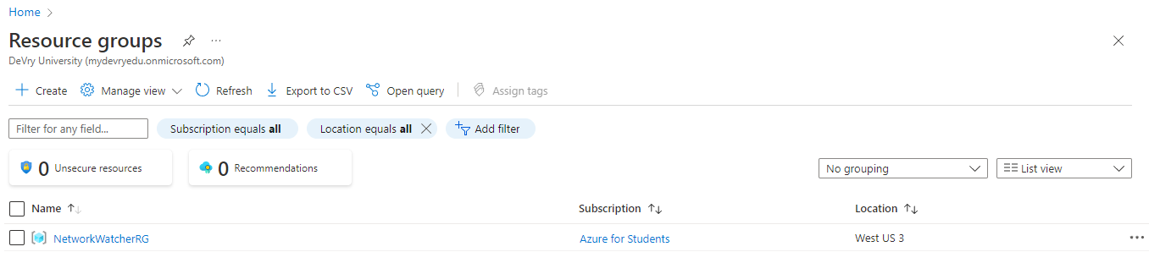
File Encryption
This screenshot should show the following.
Content of the plaintext file
Content of the encrypted file

Slide 4
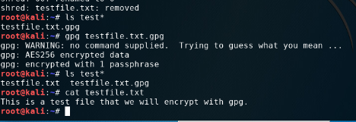
File Decryption
This screenshot should show the following.
The encrypted file being listed by itself
The decrypting process
Both the encrypted file and the original plaintext file being listed

